Slide 1
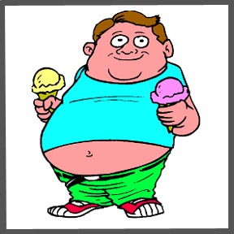
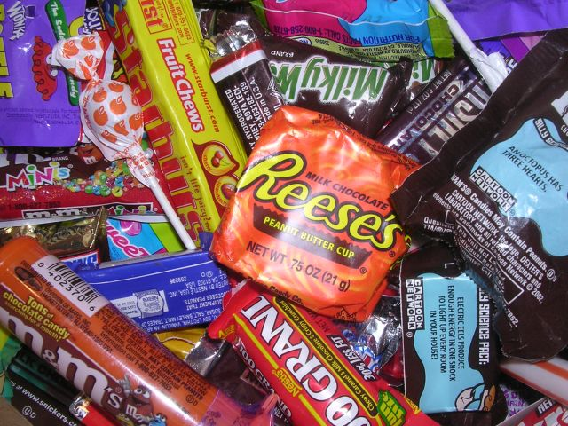
Obesity
Unhealthy dietary choices and a lack of physical activity are the leading causes of obesity.

Slide 2
What is Obesity?
Obesity is when you have excess body fat which has accumulated to the point where you have an adverse effect on your health.
Obesity can lead to reduced life expectancy and/or increased health problems.

Slide 3
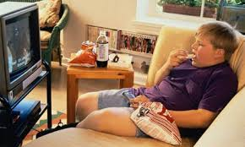
Some causes of Obesity
A lack of physical activity
Dietary choices (unhealthy food)
Changing society
High stress
Family Eating Habits

Slide 4
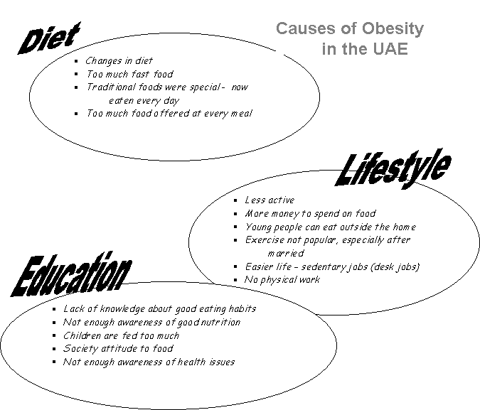

Slide 5
Other factors that cause Obesity
Age
As you get older, your body's ability to metabolize food slows down and you do not require as many calories to maintain your weight.
Gender
Women tend to be more overweight than men. Men have a higher resting metabolic rate (meaning they burn more energy at rest) than women, so men require more calories to maintain their body weight.

Slide 6
Environment
Your environment has a direct effect on your lifestyle and plays a role in what you eat and the amount of physical activity you get.
Genetics
Obesity (and thinness) tends to run in families. In a study of adults who were adopted as children, researchers found that participating adult weights were closer to their biological parents' weights than their adoptive parents'. Genetic makeup is an important factor that can cause obesity

Slide 7
Obesity Health Risks
Obesity increases a persons risk for
Heart disease
Type 2 diabetes
High blood pressure
Stroke
Gallbladder disease
Breathing problems
And certain types of cancer

Slide 8
How Obesity can be reduced?
Support from your environment and community is vital in shaping your decisions and helping you live a healthier lifestyle.
Follow a healthy eating plan and focus on proportion size.
Increase consumption of fruits and vegetable, as well as legumes, whole grains, and nuts
Limit the intake of sugars
Healthy food does not have to taste BAD!!

Slide 9
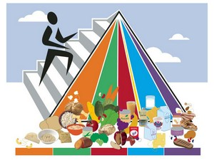
Be active. Find activities you will enjoy doing.
Reduce screen time (2 hours or less). Limit the use of TVs, computers, DVDs, and videogames because they limit time for physical activity.

Slide 10
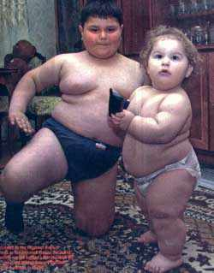
Did you know…
At least 2.8 million people die each year globally as a result of being overweight or obese.
Approximately 9% of Canadian children are obese, and 26% are over the healthy weight range - and the rates are on the rise.

Slide 11
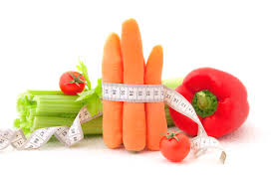
EAT HEALTHY & BE FIT!!

